Slide 1
Autonomous Car Manufacturer
Kalogiannis Konstantinos

Slide 2
Car industry
Conventional Vehicles
4 trillion revenue
Big players known
(Semi)Autonomous Vehicles
10s of Billions
Volatile
Early environment
Notes:
I will not tire you with stuff you know better than me, the vehicles we produce fall under both categories, with the second being a newly emerging environment worth of tens of billions. With two key factors where one feeds the other, consumers do not trust a less than 100% security and that is because their agency is taken away and secondly, each setback has a multiplied cost because our models will be perceived as less safe.

Slide 3

Threats
 | Script Kiddie | Employee | State hackers | Competitor’s Hackers
Sensor malfunction
Data leakage
Signal jamming
IP theft
Service downtime
Amenity misbehaviour
Notes:
Our main threats are generalized in four categories. Script kiddies or amateurs, disgruntled employees, state hackers and competitors’ backed hackers. IP theft is specifically targeted for IP in our cars and not for example our data analysis algorithms and procedures, these are all grouped in data leakage.

Slide 4
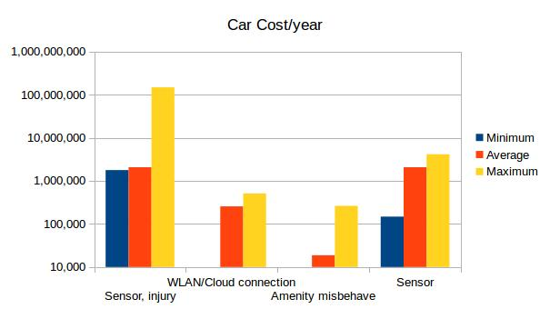
Customer losses
Losses based on car parts/value
Injury is tricky and costly
Notes:
These are the costs associated with threats targeting the car. In general the costs are based on replacing a faulty part for example in the case of a faulty sensor or losing the sale of one or two cars. The most notable thing here is of course the cost stemming from injury and in the worst case scenario from death and in Europe where our market mainly resides, the average cost of death from car accidents are around 2,5 million euros. This cost though can be mitigated with several factors but lets move on.

Slide 5
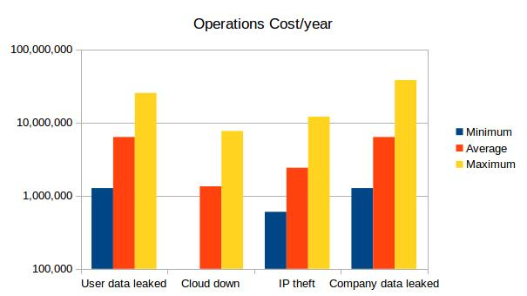
Operational losses
Company data
Car logs
Car data
Business data
IP theft
Car components
Notes:
We have substantial operational costs, more than the car’s. Most of the costs are in the range of millions or tens of millions and includes not only sales lost because of competitive advantage depending on what is leaked but also loss of reputation. Cloud is down costs us not only through losing logs and data used for improving our products but also from potential disatisfied customers.

Slide 6
Defense strategies
Cost effectiveness
Outsource
In-house
Good results?
Time availability
How long till we get results
Notes:
Azure = 3000/month
The ideal solution would be to do everything concurrently but that is not possible not only because of the inherent cost of designing and implementing the defensive mechanism but also because of the work hours needed by the the affected departments that could be spent more effectively somewhere else. In the case of outsourcing the work, can we be sure that we have the best results?

Slide 7
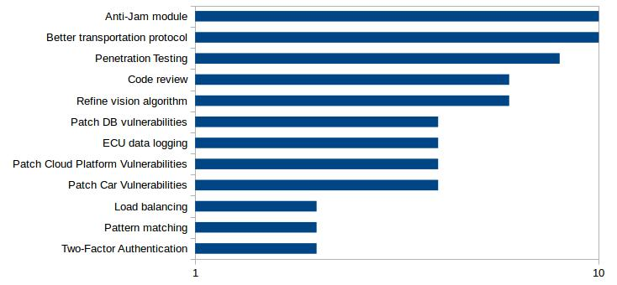
Defense Cost
Notes:
This leads us to prioritize

Slide 8
The end
Thank you for not sleeping!

Slide 9
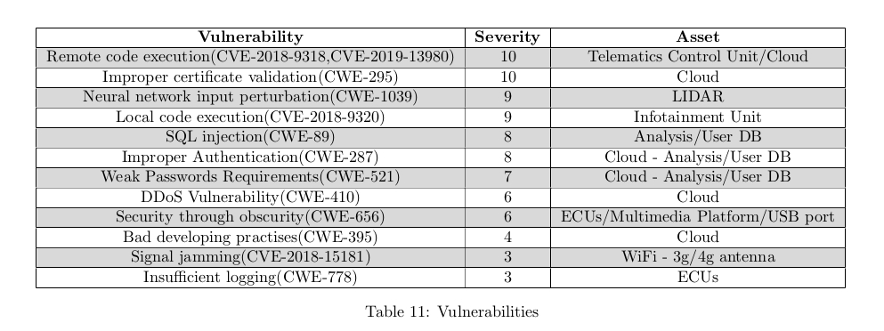
Vulnerabilities

Slide 10
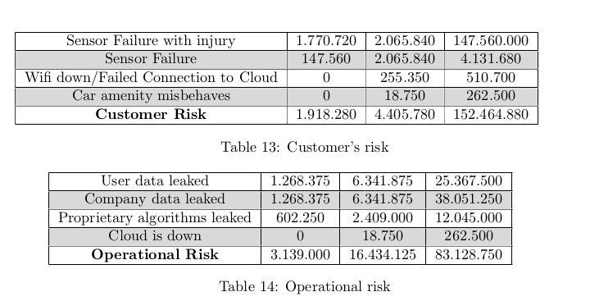
Detailed Cost

Slide 11
Defense Cost
Notes:
This leads us to prioritize

